Slide 1
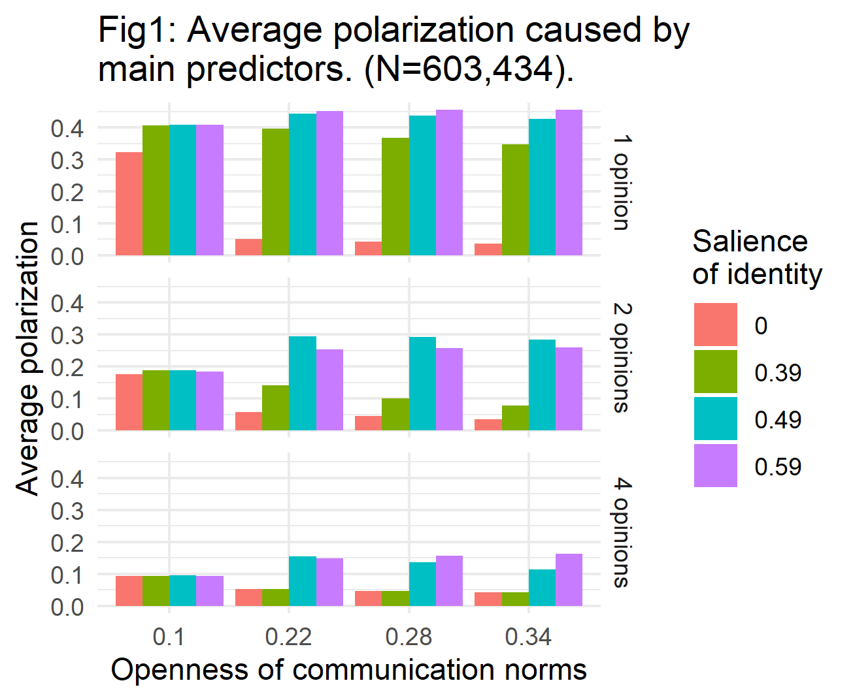
Simulating Components of the Reinforcing Spirals Model and Spiral of Silence: An Agent-Based Modeling Approach
František Kalvas, University of West Bohemia (Czech Republic), Ashley Sanders-Jackson, Michigan State University (USA), Ashwin Ramaswamy, Ashoka University (India), Mike Slater, The Ohio State University (USA)
INTRODUCTION
Polarization has significant impact on the ability to implement health and political change
Spiral of Silence and Reinforcing Spirals are two dynamic models that describe the polarization processes
We apply agent-based modeling approaches to elucidate theoretical underpinnings and understand the dynamic processes to reach equilibrium states for communication networks
We describe methodological processes and empirical findings to developing these models
RESEARCH QUESTIONS
RQ1: Can the Hegselmann-Krause algorithm create polarized public opinion?
RQ2: How does acceptability of different opinion impact polarization?
RQ3: How does salience of identity impact polarization?
RQ4: How does properties of communication network impact polarization?
RQ5: Does doe pressure to conform impact polarization?
RQ6: How does number of opinion dimensions impact polarization? RQ7: How does probability of speaking impact polarization?
METHODS
Netlogo. We utilize Netlogo, an agent-based modeling piece of software, to develop emergent systems to study the process of polarization
Hegselmann-Krause model (HK).
ESBG measure of polarization (0-1 scale).
Stepwise regression. We completed a series of stepwise regression models to determine the impact of variables of interest on our ABM. We only display the final model on this handout.
VARIABLES OF INTEREST
Opinions (1, 2, 4) indicating how many dimensions does the opinion space have.
Salience of identity is measured using identity threshold (0-1 scale) which determines minimum similarity between two agents for them to be included in part of a community
Openness of communication norms is measured using boundary (0-1 scale) with a boundary closer to 1 indicating a willingness to accept very different opinions and use them for updating own opinion.
Probability of speaking (0-1) with 1 indicating a greater probability of speaking.
Conformity level (0-1) with 1 indicating a greater conformity and a faster movement to seen concensus.
Rewiring (0-1) probability of rewiring edge of small-world network, with 1 indicating the network of interpersonal communication is close to random network, 0 indicating the clear small-world network.
Neighbors (1-128) number of neighbors in communication neighborhood.
RESULTS
Tab1: Regression predicting contributors to polarization. (N=603,434; R²=51.6% ).
Variable | Coefficient
Opinions (2) | -0.159***
Opinions (4) | -0.244***
Salience of identity (0.39) | .167***
Salience of identity (0.49) | .263***
Salience of identity (0.59) | .259***
Openness of comm. norms | -0.194***
Probability of speaking | -0.012***
Conformity level | -0.003
Rewiring | -0.003
Neighbors | -0.0001***
Constant | .227***
*** significant at the .001 level
CONCLUSIONS
Results suggest that the HK can be used to model communication processes focused on polarization. Our speaking variable did not significantly impact our model, nor did our network variables. However, salience of identity, number of opinons, and openness of communication norms did significantly impact polarization. Future work should consider other parameterizations of social network variables, including a focus on social media and polarized initial state of simulations.

Slide 2
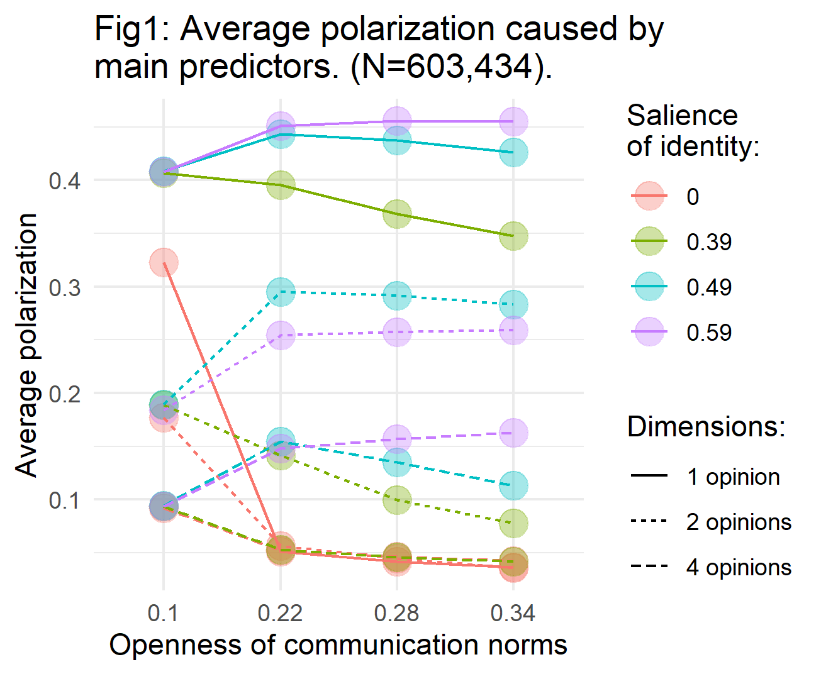
Simulating Components of the Reinforcing Spirals Model and Spiral of Silence: An Agent-Based Modeling Approach
František Kalvas, University of West Bohemia (Czech Republic), Ashley Sanders-Jackson, Michigan State University (USA), Ashwin Ramaswamy, Ashoka University (India), Mike Slater, The Ohio State University (USA)
INTRODUCTION
Polarization has significant impact on the ability to implement health and political change
Spiral of Silence and Reinforcing Spirals are two dynamic models that describe the polarization processes
We apply agent-based modeling approaches to elucidate theoretical underpinnings and understand the dynamic processes to reach equilibrium states for communication networks
We describe methodological processes and empirical findings to developing these models
RESEARCH QUESTIONS
RQ1: Can the Hegselmann-Krause algorithm create polarized public opinion?
RQ2: How does acceptability of different opinion impact polarization?
RQ3: How does salience of identity impact polarization?
RQ4: How does properties of communication network impact polarization?
RQ5: Does doe pressure to conform impact polarization?
RQ6: How does number of opinion dimensions impact polarization? RQ7: How does probability of speaking impact polarization?
METHODS
Netlogo. We utilize Netlogo, an agent-based modeling piece of software, to develop emergent systems to study the process of polarization
Hegselmann-Krause model (HK).
ESBG measure of polarization (0-1 scale).
Stepwise regression. We completed a series of stepwise regression models to determine the impact of variables of interest on our ABM. We only display the final model on this handout.
VARIABLES OF INTEREST
Opinions (1, 2, 4) indicating how many dimensions does the opinion space have.
Salience of identity is measured using identity threshold (0-1 scale) which determines minimum similarity between two agents for them to be included in part of a community
Openness of communication norms is measured using boundary (0-1 scale) with a boundary closer to 1 indicating a willingness to accept very different opinions and use them for updating own opinion.
Probability of speaking (0-1) with 1 indicating a greater probability of speaking.
Conformity level (0-1) with 1 indicating a greater conformity and a faster movement to seen concensus.
Rewiring (0-1) probability of rewiring edge of small-world network, with 1 indicating the network of interpersonal communication is close to random network, 0 indicating the clear small-world network.
Neighbors (1-128) number of neighbors in communication neighborhood.
RESULTS
Tab1: Regression predicting contributors to polarization. (N=603,434; R²=51.6% ).
Variable | Coefficient
Opinions (2) | -0.159***
Opinions (4) | -0.244***
Salience of identity (0.39) | .167***
Salience of identity (0.49) | .263***
Salience of identity (0.59) | .259***
Openness of comm. norms | -0.194***
Probability of speaking | -0.012***
Conformity level | -0.003
Rewiring | -0.003
Neighbors | -0.0001***
Constant | .227***
*** significant at the .001 level
CONCLUSIONS
Results suggest that the HK can be used to model communication processes focused on polarization. Our speaking variable did not significantly impact our model, nor did our network variables. However, salience of identity, number of opinons, and openness of communication norms did significantly impact polarization. Future work should consider other parameterizations of social network variables, including a focus on social media and polarized initial state of simulations.

Slide 3
